Slide 1


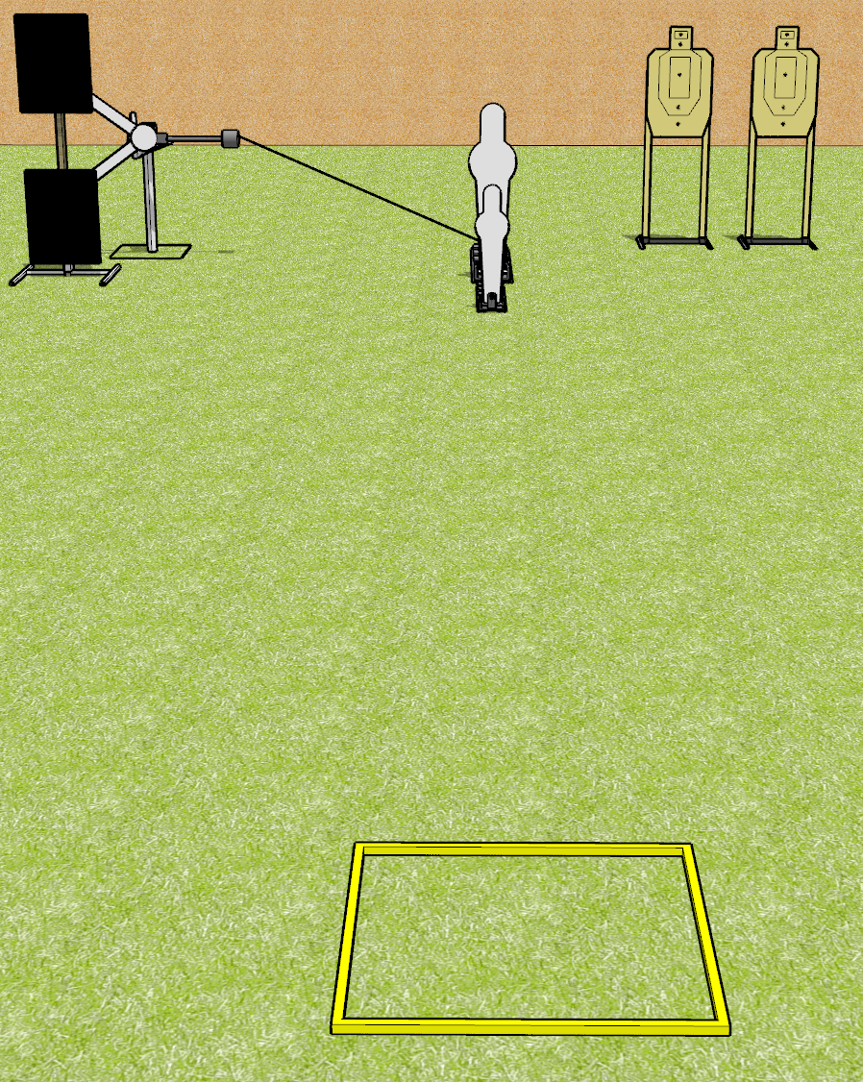
 | Dothan Gun Club – USPSA Match Four and Four Course Designer : Drew Coleman
Round Count 14 rounds 3 USPSA 1 pepper popper, 1 mini popper
Equipment List Red stitch swinger + activator Shooting box

Slide 2
Four and Four
Written Stage Briefing
Four and Four is a 12 round, 60 point, Comstock speed shoot. The best 4 hits on paper will score, and steel must fall to score. The start signal is audible.
The swinger is activated by the pepper popper, and remains visible at rest.
Handgun start position is inside shooting area with fingers touching ears or ear pro. Handgun is loaded and holstered.
PCC start position is inside shooting area, stock on belt. Loaded carbine is held with both hands, safety on.
On start signal, engage the steel OR the paper targets, perform a mandatory reload, and engage the remaining array.

Slide 3
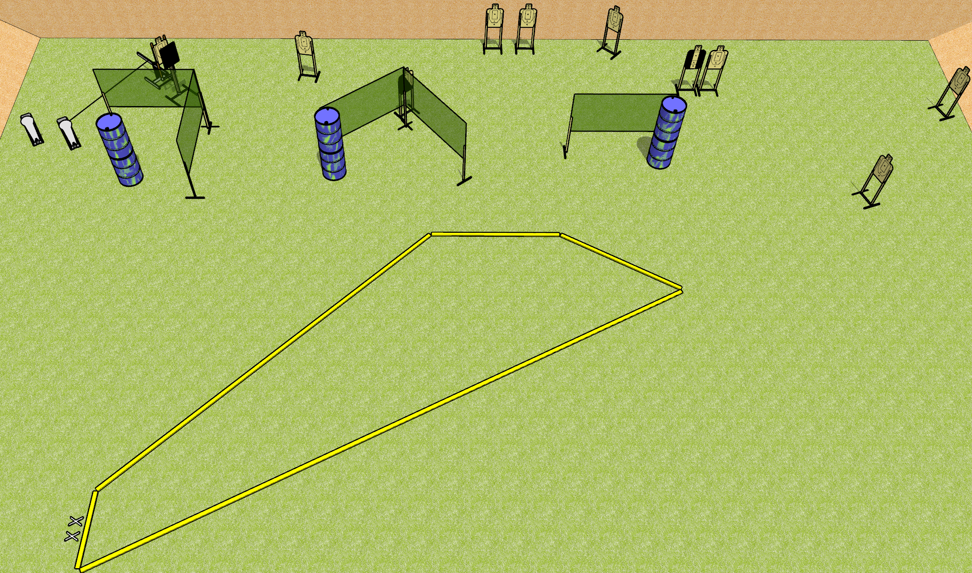
 | Dothan Gun Club – USPSA Match Bobbing Meanie Course Designer : Drew Coleman
Round Count 22 rounds 10 USPSA 2 colt poppers
Equipment List 8 wall feet Bobber + activator 1 medium fault line 1 tux, 1 left diagonal

Slide 4
Bobbing Meanie
Written Stage Briefing
Bobbing Meanie is a 22 round, 110 point, Comstock course of fire. There are 10 USPSA targets and 2 colt poppers. The best 2 hits on paper will score, and steel must fall to score. The start signal is audible.
The bobber is activated by the right colt popper and remains visible at rest. It must be activated before being engaged.
Handgun start position is completely outside the shooting area, feet on X’s, wrists below belt. Handgun is loaded and holstered.
PCC start position is completely outside the shooting area, feet on X’s, stock on belt. Loaded carbine is held with both hands, safety on.
On start signal, engage targets as they become available from within the shooting area.

Slide 5
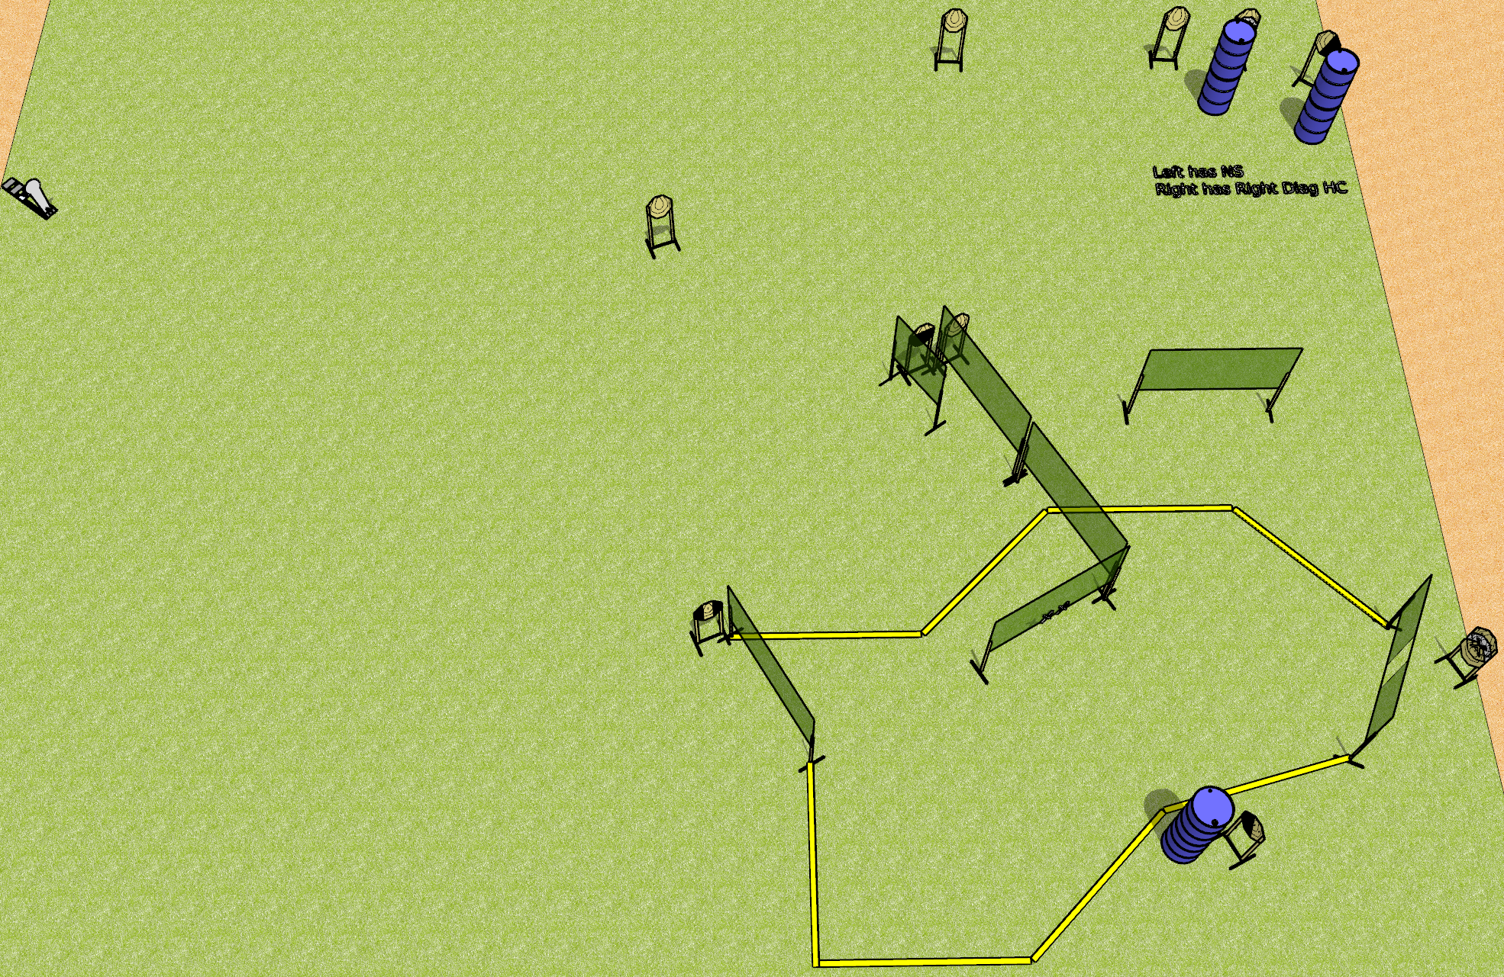
 | Dothan Gun Club – USPSA Match Wall Hacks Course Designer : Drew Coleman
Round Count 23 rounds 11 IPSC 1 colt popper
Equipment List 12 wall feet All 10’ fault lines 1 tux, 1 50%, 1 left and 1 right diag
XX

Slide 6
Wall Hacks
Written Stage Briefing
Wall Hacks is a 23 round, 115 point, Comstock course of fire. There are 11 IPSC targets and 1 colt popper. The best 2 hits on paper will score, and steel must fall to score. The start signal is audible.
Handgun start position is both hands touching marks. Handgun is unloaded and holstered.
PCC start position is muzzle touching either mark, stock on belt. Unloaded carbine is held with both hands.
On start signal, engage targets as they become available from within the shooting area.

Slide 7
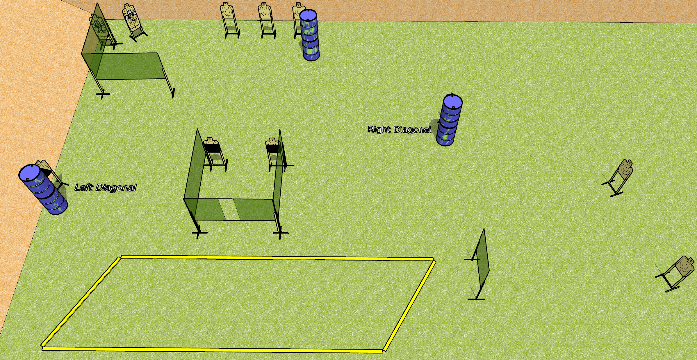
 | Dothan Gun Club – USPSA Match Rhombus of Annoyance Course Designer : Drew Coleman
Round Count 26 rounds 13 USPSA
Equipment List 9 wall feet 1 left and 1 right diag, 2 50% All 10’ fault lines

Slide 8
Rhombus of Annoyance
Written Stage Briefing
Rhombus of Annoyance is a 26 round, 130 point, Comstock course of fire. There are 13 USPSA targets. The best 2 hits on paper will score. The start signal is audible.
Handgun start position is inside the shooting area, wrists below belt. Handgun is loaded and holstered.
PCC start position is inside the shooting area, stock on belt. Loaded carbine is held with both hands, safety on.
On start signal, engage targets as they become available from within the shooting area.

Slide 9
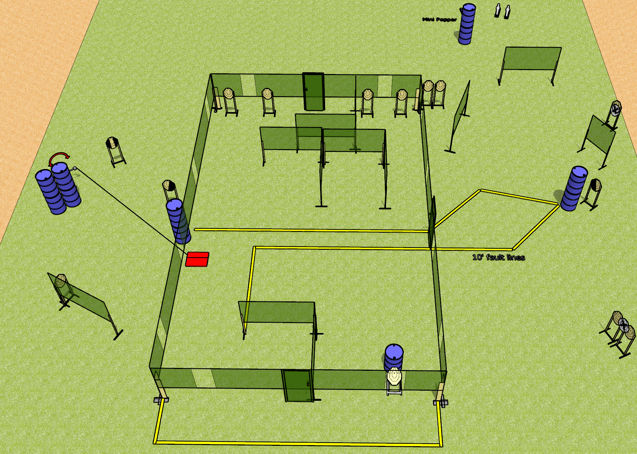
 | Dothan Gun Club – USPSA Match Shoothouse Shuffle Course Designer : Drew Coleman
Round Count 33 rounds 15 IPSC 3 mini poppers
Equipment List 8 wall feet 3 medium fault lines Swinger + stomp box 1 left + 1 right diag, 1 tux

Slide 10
Shoothouse Shuffle
Written Stage Briefing
Shoothouse Shuffle is a 33 round, 165 point, Comstock course of fire. There are 15 IPSC targets and 3 mini poppers. The best 2 hits on paper will score and steel must fall to score. The start signal is audible.
The swinger is activated by the stomp box and remains visible at rest. The stomp box is part of the shooting area
All doors must be shut at the start signal.
Handgun start position is fingers of both hands touching front door handle. Handgun is loaded and holstered.
PCC start position is muzzle touching front door handle, stock on belt. Loaded carbine is held with both hands, safety on.
On start signal, engage targets as they become available from within the shooting area.

